Slide 1
#06 Methods, parameters, scope and properties
Notes:
Give an explanation for the concepts method, parameter scope and property
Relevant theoretical decisions
What is a method, when and how is it used?
What kind of methods is common in C# programs?
What is the difference between arguments and parameters?
What is the difference between value and reference parameters?
What is meant by the word scope?
What are properties, how and why are they used or useful?

Slide 2
Methods
Parameters
Return type
Static modifier
Access modifiers
Inheritance modifiers
Notes:
A method performs an action in a series of statements.
Parameters: A method can receive input data from the caller by specifying parameters
Return type: Output can send data back to the caller by specifying a return type. A method can specify a void return type, indicating that it doesn't return any value to its caller.
Static modifier: Static modifier makes the method static within the class. (same instance in each object)
Access modifiers: Access modifiers define how the method can be accessed: public internal private protected
Inheritance modifiers: Use for inheritance; new virtual abstract override sealed

Slide 3
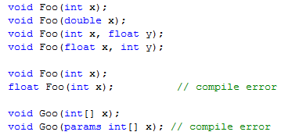
Overloading Methods
Methods in C# can be overloaded
Notes:
A type may overload methods (have multiple methods with the same name), as long as the signatures are different. For example, the following methods can all coexist in the same type:
Some pairs of methods cannot coexist in the same type, :

Slide 4

Parameters and Arguments
These two terms are often used interchangeably;
Parameter is variable in the declaration of function.
Argument is the actual value of this variable that gets passed to function.
Notes:
Parameters Vs Arguments: it's only a point of view problem. If you look from the caller's point of view, they're arguments. If you look from the callee's point of view, they're parameters.
Parameter is variable in the declaration of function.
Argument is the actual value of this variable that gets passed to function.
void Foo(int x, int y); // x and y are parameters Foo(1, 2); // 1 and 2 are arguments

Slide 5
Value and Reference Parameters
value types
ref parameters
out parameters
Notes:
Because you can’t return three values, perhaps you can pass in three parameters, let the method modify the parameters, and examine the result in the calling method.
value types are passed into methods by value.
ref parameters are used to pass value types into a method by reference. This allows you to retrieve their modified values in the calling method.
out parameters are used only to return information from a method. Does not have to be set

Slide 6
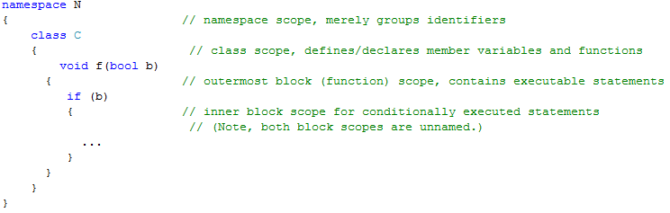
Scope
Scope is the range in which a variable can be referenced.
Access modifier influence the scope
i.e. Private makes the method or field only visible within the class
Notes:
Scope is the range in which a variable can be referenced.
Typically, scope is used to define the extent of information hiding--that is, the visibility or accessibility of variables from different parts of the program.
Scopes can:
contain declarations or definitions of identifiers;
contain statements and/or expressions which define an executable algorithm or part thereof;
nest or be nested.
A namespace is a scope that uses the enclosing nature of the scope to group logically related identifiers under a single identifier.

Slide 7
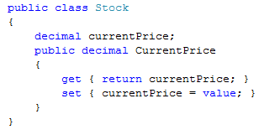
Properties
Many examples uses fields though properties are more practical
A property is declared like a field
but with a { get {} set {} } block added
The implementer has total access
But fields is encapsulate from the user, securing robustness
Notes:
Throughout this book, we use public fields extensively to keep the examples free of distraction. In a real application, you would typically favor public properties over public fields, in order to promote encapsulation.
Properties look like fields from the outside but act like methods on the inside.
A property is declared like a field, but with a { get {} set {} } block added. get and set denote property accessors.
Although properties are accessed in the same way as fields, they differ in that they give the implementer complete control over getting and setting its value. This control enables the implementer to choose whatever internal representation is needed, without exposing the internal details to the user of the property.

Slide 8
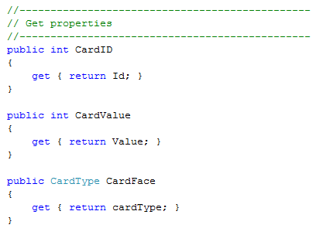
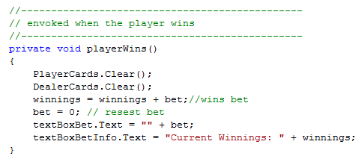
Excerpt from our program
A method within our BlackJackWindow class
Properties in Card class
Notes:
Example of methods and properties in our application. The properties of Card class only have get, we don’t need set, since the fields are set in the constructor.

Slide 9
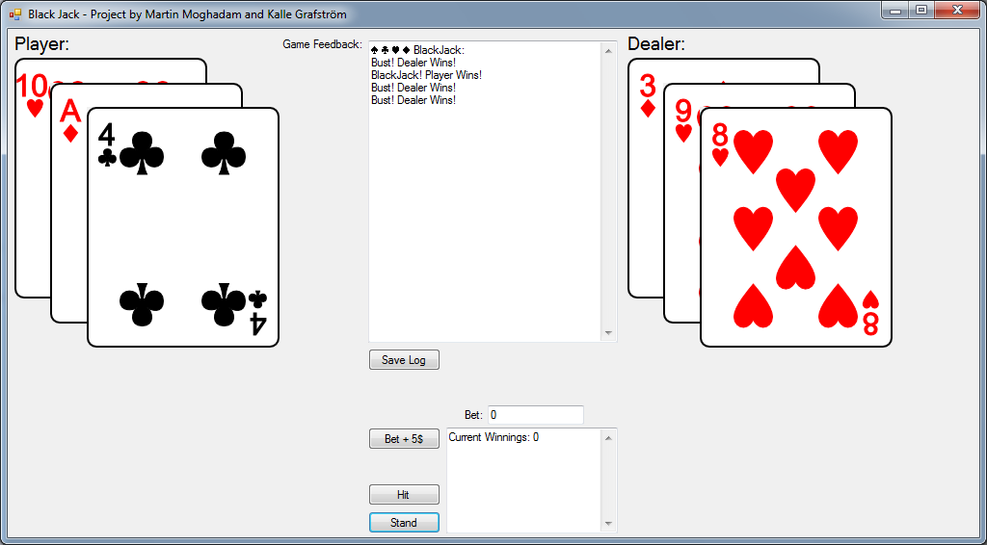
Our program
Black Jack Game
Log
Save Log
Beting
Hit
Stand

Slide 10
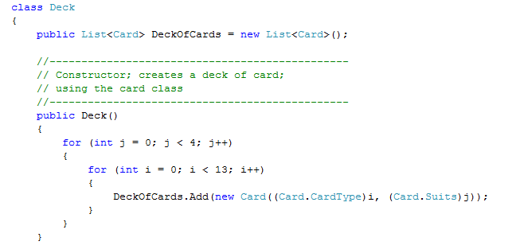
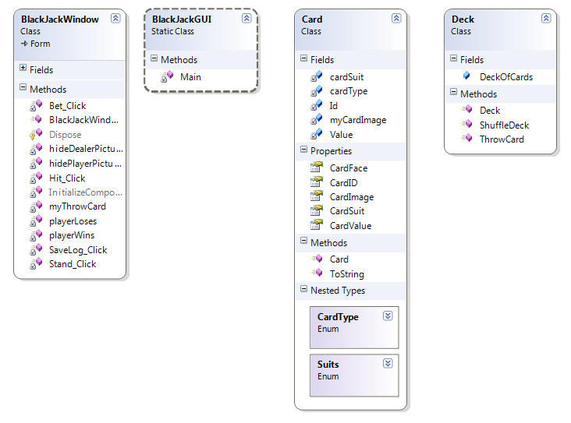
Our program
List and foreach in our application
Notes:
Our application uses list to contain the cards and the foreach statement to manage the cards
Our application contains a simple card class, and a deck class.
A deck of cards is a list that contains objects of the type card.

Slide 11
Questions?

